Slide 1
The Poverty Measure
Owen Gaustad

Slide 2
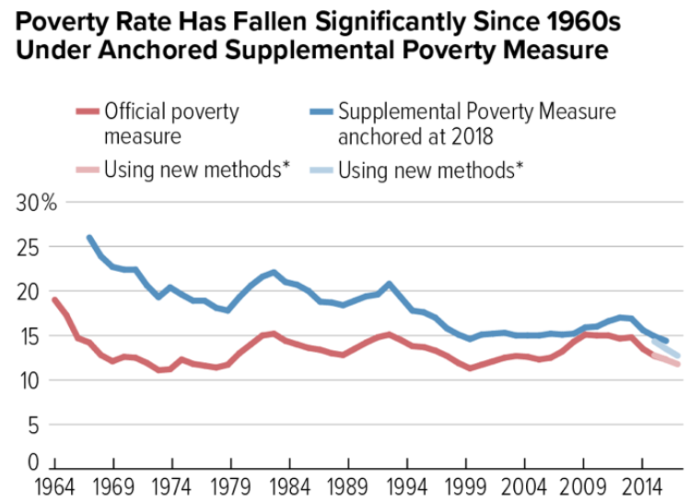
Review:
Mollie Orshansky
First Poverty Threshold Equation
Thesia I. Garner
Senior Research Economist. Bureau of Labor Statistics
David Betson
Associate Professor of Public Policy and Economics
Official Poverty Measure
Supplemental Poverty Measure

Slide 3
Deep Dive into the SPM
Variables regarding cost:
Variables to scale based on family:
Food
Clothing
Shelter
Utilities
Style of Homeownership
Renting/Mortgage/No Mortgage
Parameter for first child
Parameter for additional children
Parameter for economy
# of Children
# of Adults

Slide 4
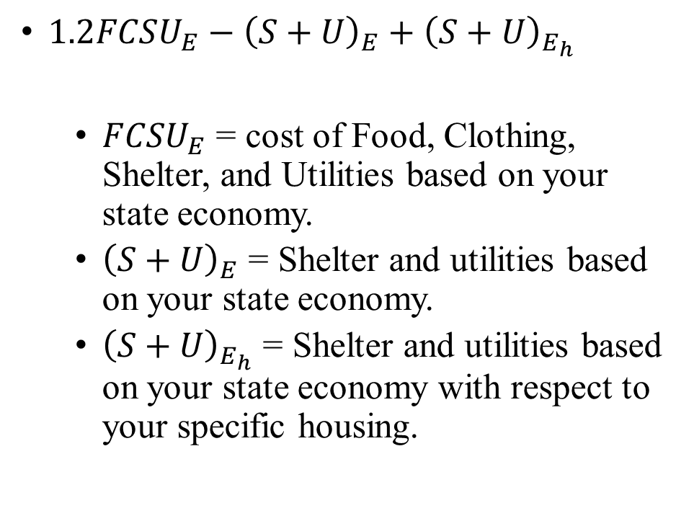
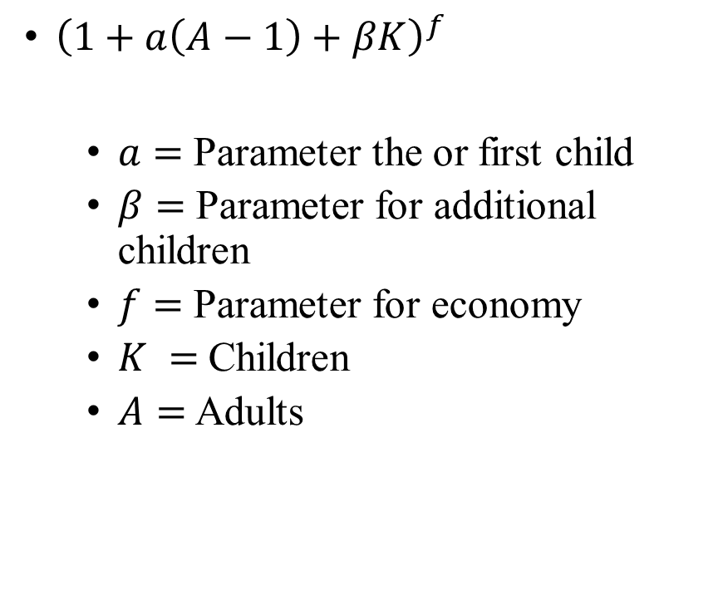
Multiplier Formula:
Poverty Formula:
${\left(1+a\left(A−1\right)+βK\right)}^{f}$
$a=$Parameter the or first child
$β=$Parameter for additional children
$f=$Parameter for economy
$K =$Children
$A=$ Adults
$1.2FCSU_{E}−{\left(S+U\right)}_{E}+{\left(S+U\right)}_{E_{h}}$
$FCSU_{E}$ = cost of Food, Clothing, Shelter, and Utilities based on your state economy.
${\left(S+U\right)}_{E}$ = Shelter and utilities based on your state economy.
${\left(S+U\right)}_{E_{h}}$ = Shelter and utilities based on your state economy with respect to your specific housing.

Slide 5
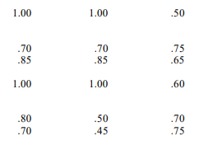

Multiplier Formula:
$a$ $β$ $f$
${\left(1+a\left(A−1\right)+βK\right)}^{f}$
$a=$Parameter the or first child
$β=$Parameter for additional children
$f=$Parameter for economy
$K =$Children
$A=$ Adults

Slide 6
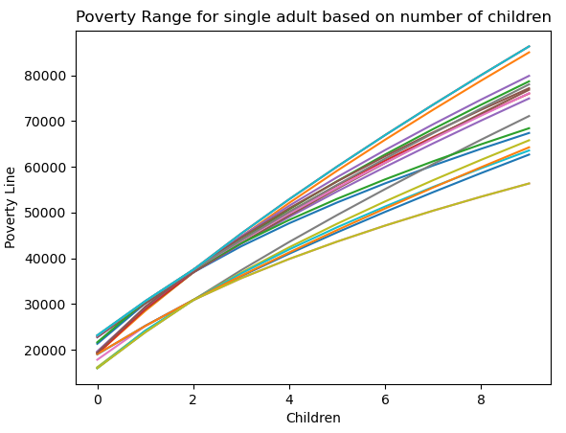
All the variables David came up with give very different values for the poverty line.
However, this does give us a poverty zone.
What does that look like?

Slide 7
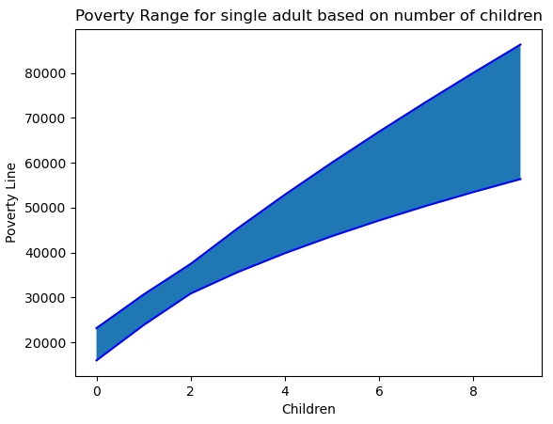
Consider this area in blue the “danger zone”
If you are below the danger zone you are in poverty.
In the danger zone you are at risk of being in poverty.
Above the danger zone be careful.

Slide 8
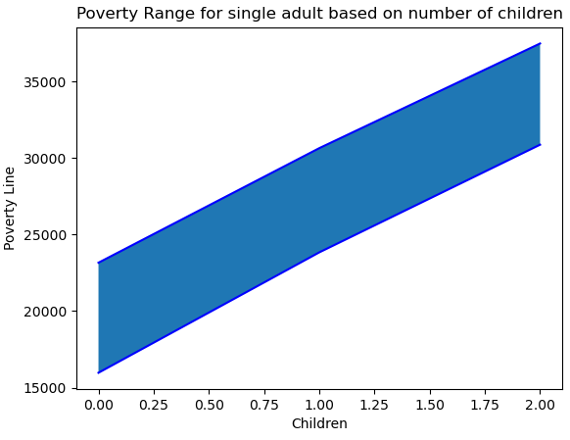
If you view the poverty line this way, it becomes much easier to look at policy.
For instance, if anything below $15k a year is by all metrics in poverty for a single adult with no kid. Let’s set that as the UBI.

Slide 9
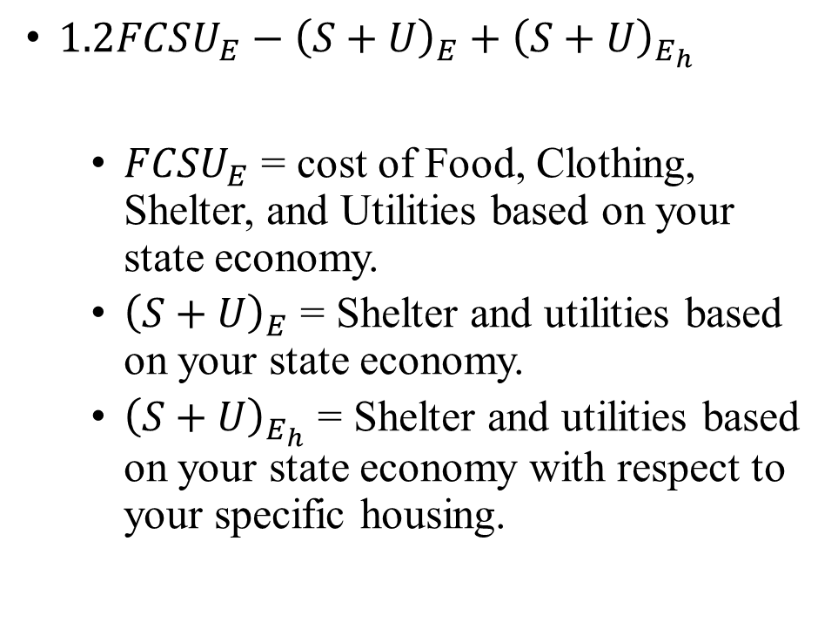
Let’s look again at the Poverty Formula:
If policymakers want to lower poverty this equation, they see says you should be giving out government subsidies for food and clothes.
It also tells us we should be capping shelter and utility costs.
$1.2FCSU_{E}−{\left(S+U\right)}_{E}+{\left(S+U\right)}_{E_{h}}$
$FCSU_{E}$ = cost of Food, Clothing, Shelter, and Utilities based on your state economy.
${\left(S+U\right)}_{E}$ = Shelter and utilities based on your state economy.
${\left(S+U\right)}_{E_{h}}$ = Shelter and utilities based on your state economy with respect to your specific housing.

Slide 10
In Summation:
If you look at all the data collected to create the SPM it doesn’t give you a line, it gives you an area.
This allows us to view poverty in a slightly different light.
The SPM also tells policymakers exactly what they should be focusing on.

